Slide 1
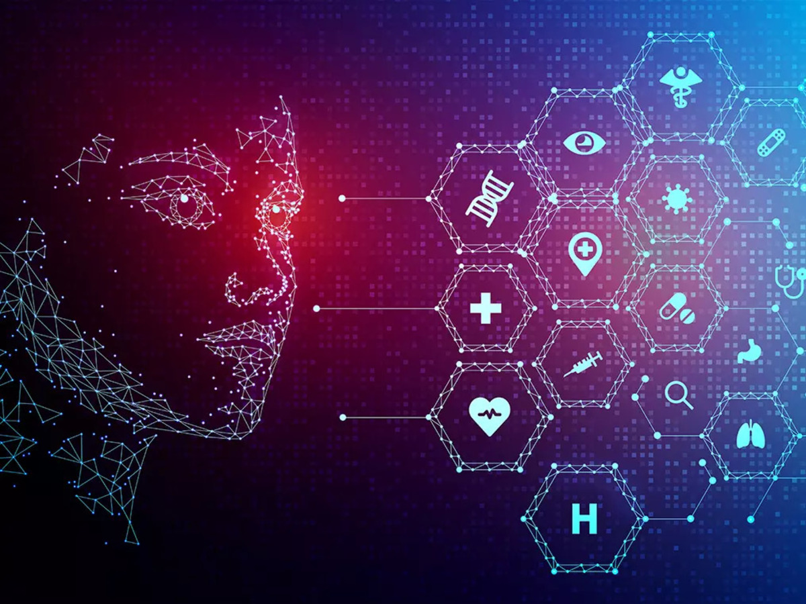


SILIGURI INSTITUTE OF TECHNOLOGY DEPARTMENT OF ELECTRICAL ENGINEERING
PRESENTATION ON_HUMAN ACTION RECOGNITION
By (Group 2):
Sagar Mondal
Divya Gupta
Priyashree Nandi
Amit Kumar Ram
Subhankar Roy

Slide 2
CONTENT
Introduction to the project
What is the action recognition
Activities divided in different category
Introduction of the dataset
Background study
Problem statement
Solution approacd
Code Output
Contribution
Conclusion
Reference

Slide 3
Introduction to the project
First of we need to understand - what is the machine learning? Machine learning is a subfield of artificial intelligence, which is broadly defined as the capability of a machine to imitate intelligent human behavior. Artificial intelligence systems are used to perform complex tasks in a way that is similar to how humans solve problems.
The aim of our project is to understand human behavior and assign a label to each action. It has a wide range of applications, and therefore has been attracting increasing attention in the field of computer vision. Take a video or image input and identify the action that is being performed by the person in the video. The actions can be anything from applying makeup, dancing , singing,football, etc.

Slide 4
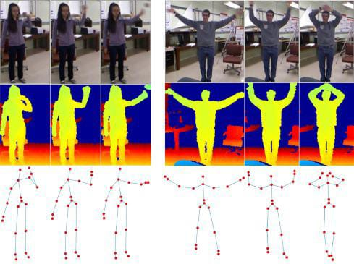
What is the action recognition
Human action recognition is the very interesting problem where the main goal is to analyze a video and recognize the action being performed by the person in the video. There are two type of action Some simple action like standing can be identified by using just a single frame for more complex action such as walking running bending or falling might required more than one frames to identify the action correctly.

Slide 5
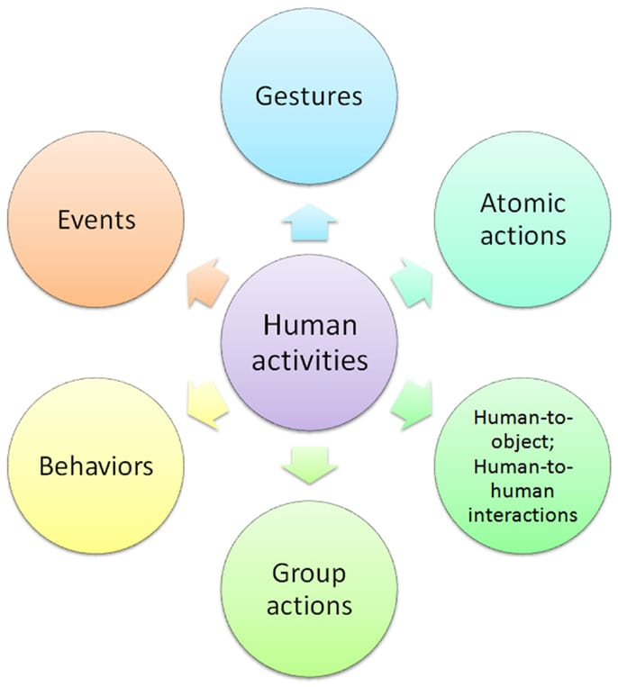
Activities are divided in different category
The goal of human activity recognition is to examine activities from video sequences or still images. Motivated by this fact, human activity recognition systems aim to correctly classify input data into its underlying activity category. Depending on their complexity, human activities are categorized into:
(i) Gestures
(ii) atomic actions
(iii) human-to-object or human-to-human interactions
(iv) group actions
(v) behaviors and
(vi) events.

Slide 6
Activities are divided in different category
Gestures are considered as primitive movements of the body parts of a person that may correspond to a particular action of this person .
Atomic actions are movements of a person describing a certain motion that may be part of more complex activities .
Human-to-object or human-to-human interactions are human activities that involve two or more persons or objects .
Group actions are activities performed by a group or persons.
Human behaviors refer to physical actions that are associated with the emotions, personality, and psychological state of the individual .
Finally, events are high-level activities that describe social actions between individuals and indicate the intention or the social role of a person.

Slide 7
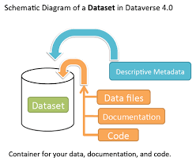
Introduction of the dataset
A dataset is a collection of records, similar to a relational database table. Records are similar to table rows, but the columns can contain not only strings or numbers, but also nested data structures such as lists, maps, and other records.
To define a dataset, Kite minimally requires a URI and a schema. Other considerations would include deciding how to partition your data and additional configuration options.
When using the CLI, you define your dataset using the create command. When using the API, you define your dataset using the Datasets. Create method.

Slide 8
Background Study
Deep learning is an area of machine learning that uses feature learning techniques instead of task-specific algorithms. It uses multi-layered artificial neural networks that work similarly to neural networks in the human brain. But unlike the brain, a neural network is divided into separate layers each with a defined direction of data processing. A network with more than two layers is called a deep neural network (DNN).
Libraries:
Imagei , open cv, tensorflow , Random , Re, Os, Tempfile, Sal , Cv2, Numpy, Urllib.

Slide 9
Problem Statement
Activity detection is a major problem in smart videos surveillance. It is a fundamental problem in computer vision, i.e. to detect the activity of human in surveillance videos. These applicants need real-time detection performance, but it is generally vey time consuming to detect the actual activity. The time consumption is due to the heavy size of the video clip of surveillance and low computation power of these systems. This heavy size is because of the resolution of the cctv camera. It becomes important to reduce the resolution of video clip and to detect what activity is been performed by the subjects. There are many solutions provided in deep learning until now, but none of them are efficient when there are lots of details in the video and it becomes difficult to detect the actual activity. In such case if rest of the details are compressed, it will be easy to apply attention to the actual activity.

Slide 10
Solution Approach
Action detection is one of the most challenging tasks in video processing. It can be useful in security systems and closed-circuit television (CCTV), facial emotion recognition software, sport event analytics, behavior observation, statistics gathering, etc.
Deep learning is an area of machine learning that uses feature learning techniques instead of task-specific algorithms. It uses multi-layered artificial neural networks that work similarly to neural networks in the human brain. But unlike the brain, a neural network is divided into separate layers each with a defined direction of data processing. A network with more than two layers is called a deep neural network (DNN).

Slide 11

Code Implementation:
Libraries
Mounting our drive
Importing libraries

Slide 12
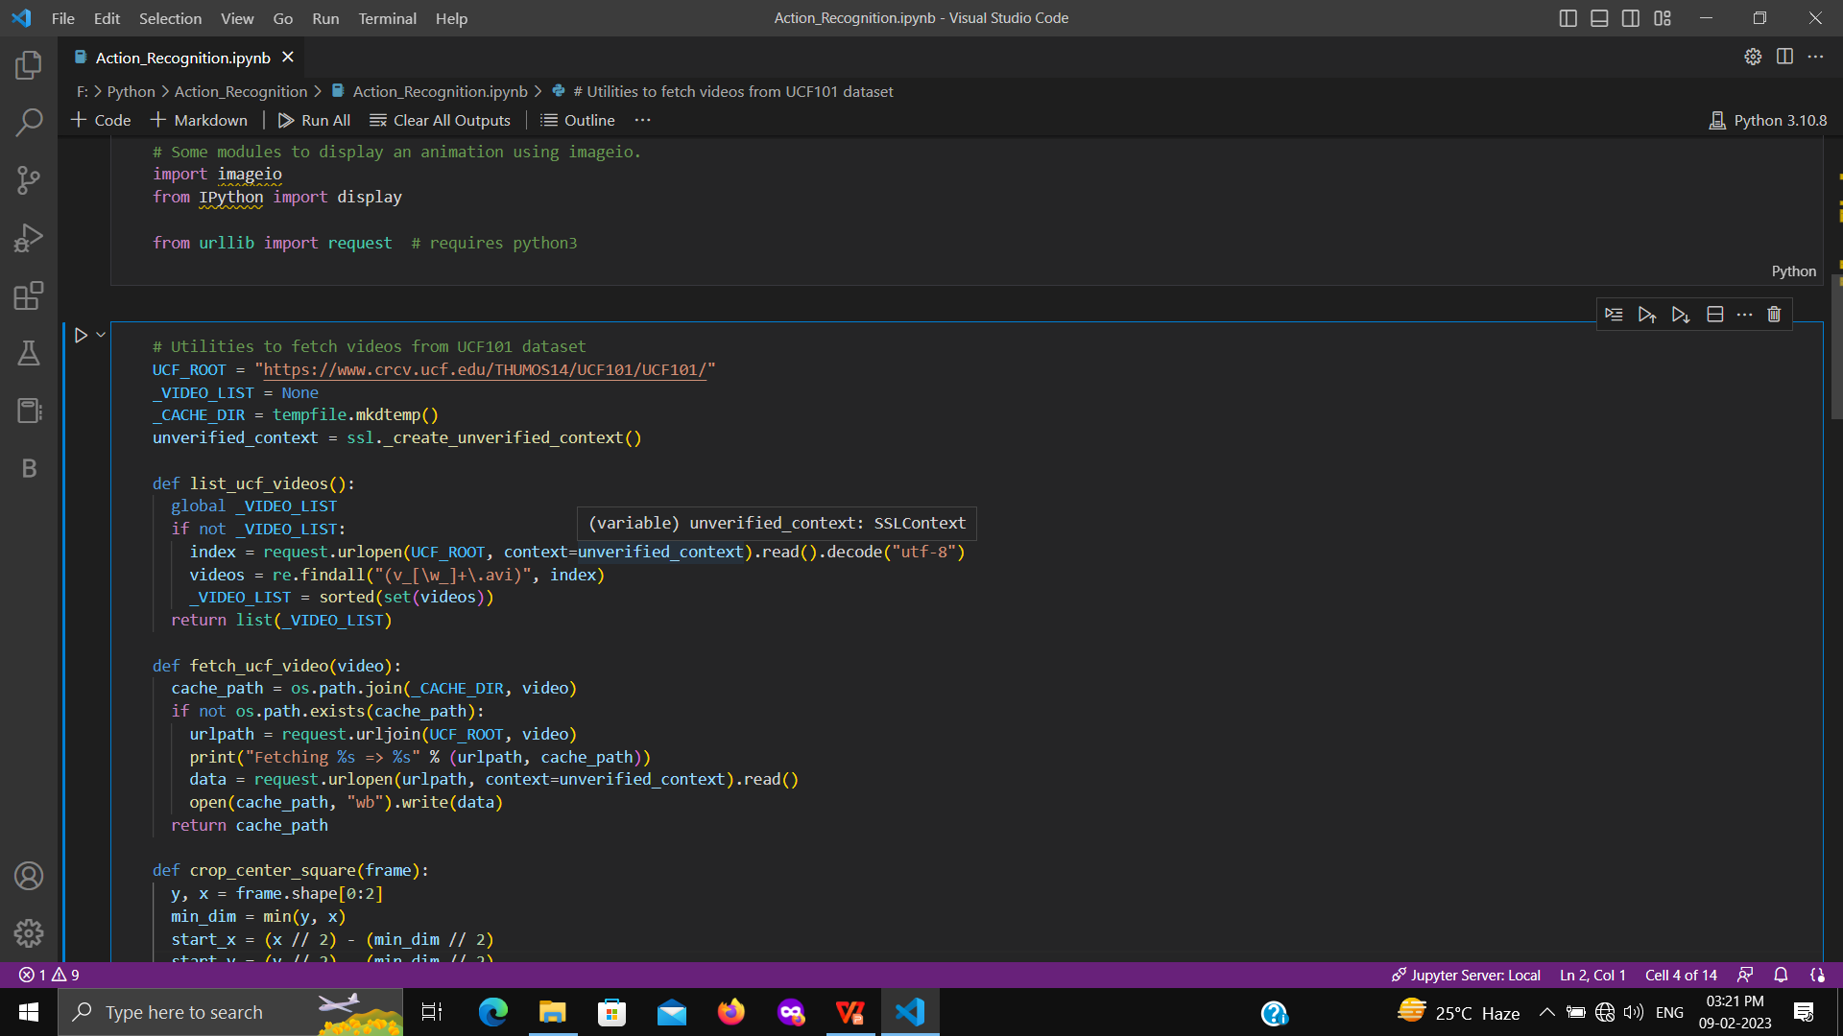
Importing Libraries
Helper functions for the UCF101 dataset

Slide 13
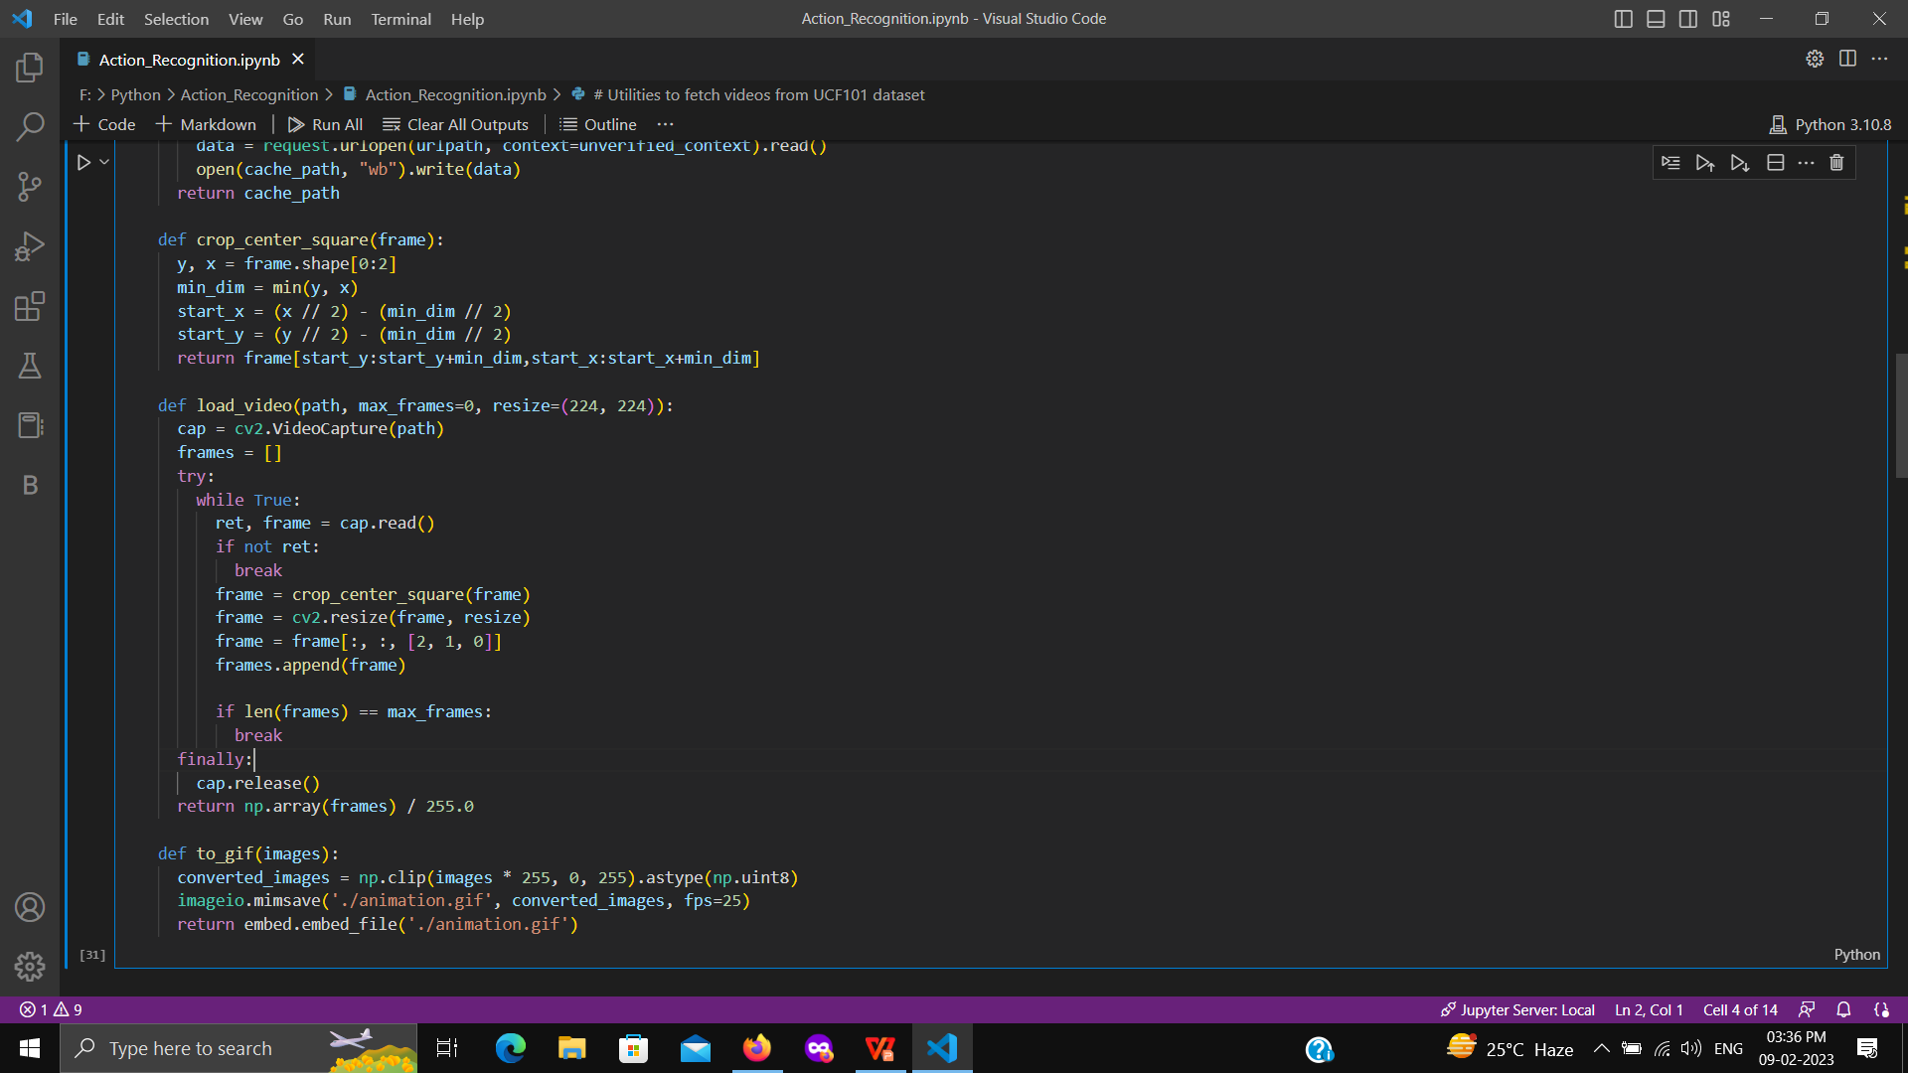
Helper functions for the UCF101 dataset

Slide 14
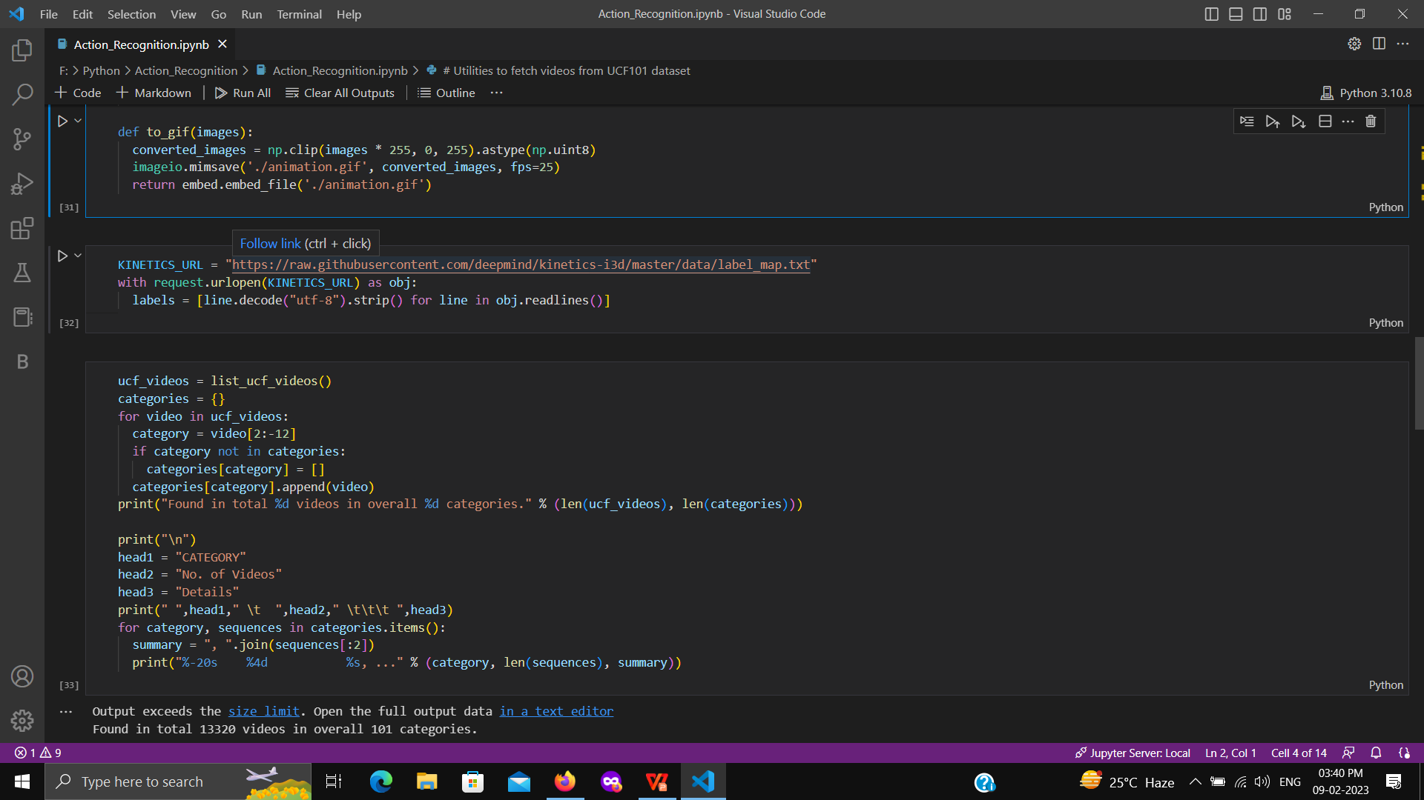
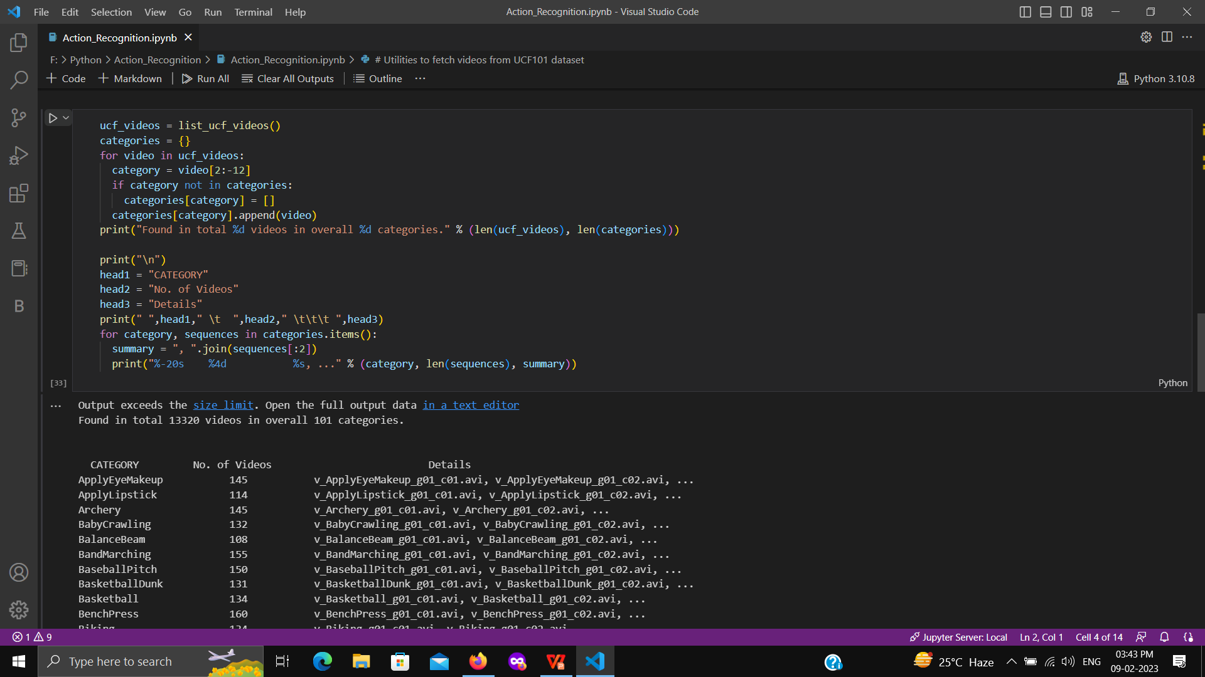
Get the kinetics-400 labels
Get UCF101 Dataset

Slide 15
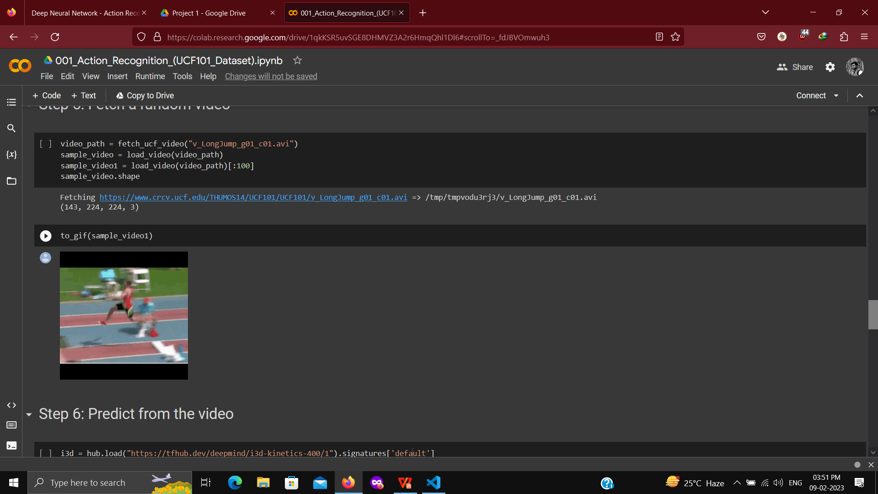
Fetch a random video

Slide 16

Predict from the video

Slide 17
OUTPUT OR RESULT
O/P of sample_video1
O/P of Sample_video

Slide 18
Contribution
Sagar Mondal(Group leader): Code section
Subhankar Roy: Data Collection
Amit Kumar Ram: Code Testing & Library Import
Priyashree Nandi: Report Writing & O/P cheeking of the code
Divya Gupta: Power Point Presentation & UCF Dataset

Slide 19
CONCLUSION
Human activity recognition has a wide range of uses because of its impact on well being.
It is becoming a fundamental tool in healthcare solutions such as preventing obesity or caring for elderly person

Slide 20
REFERENCE
[1] https://www.neuraldesigner.com/solutions/activity-recognition
[2] https://thecleverprogrammer.com/2021/01/10/human-activity-recognition-with-machine-learning/
[3] https://slideplayer.com/amp/10937846/
[4] https://upscwithnikhil.com/article/ethics/human-actions#:~:text=Human%20actions%20are%20defined%20as,one%20day%20by%20armed%20robbers
[5]https://www.frontiersin.org/articles/10.3389/frobt.2015.00028/full#:~:text=Depending%20on%20their%20complexity%2C%20human,%3B%20and%20(vi)%20events
[6] https://youtu.be/dQAwXaxczkk
[7]https://github.com/GSagarMandal/Action_Recognision.git

Slide 21
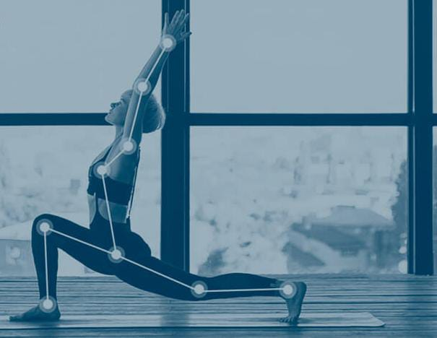
THANK YOU

